Slide 1
Origenate Systems Administration
State Farm Onsite Training
Craig Nauman
1/25/2016

Slide 2
Craig Nauman
About Me:
CMSI Employee of 18yrs and involved with Origenate and Evaluate from first release.
Manage System Integrations, Systems Architecture, Product Engineering, Performance Testing
Training:
Presentation is a guide to walk through system but details of topics are class driven.
If more details are needed then I can provide I will gather information to get questions answered.

Slide 3
Class
About you:
To me help understand the group and skill levels everyone introduce themselves and their role.
One thing you are looking to learn from training.

Slide 4
Agenda
Day 4
System Administration
System Maintenance
Day 5
System Monitoring
Review / Open Discussion
Day 1:
Introductions
Application Overview
Origenate Detail
Day 2
Evaluate Detail
Database Detail
Encryption Detail
Day 3
System Logs
System Processing
Code Deployment

Slide 5
Training Overview
Sections
Section 1 – System Overview
Section 2 – Origenate Detail
Section 3 – Evaluate Detail
Section 4 – Database Detail
Section 5 – Encryption Detail
Section 6 – System Logs
Section 7 – System Processing
Section 8 – Code Deployment
Section 9 – System Administration
Section 10 – System Maintenance
Section 11 – System Monitoring
Section 12 – Review

Slide 6
Section 1 System Overview
Topics
Components Overview
System Components
Origenate
Evaluate
Database
Encryption

Slide 7
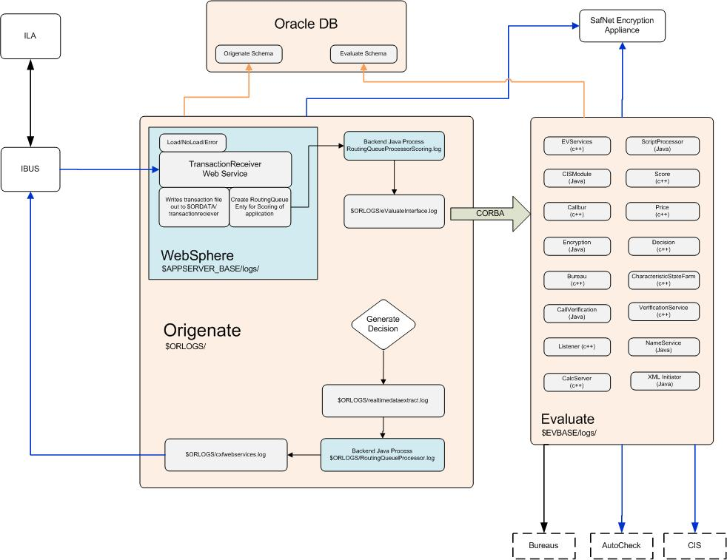
Component Overview

Slide 8
System Components
Origenate
WebSphere 8.5.5
Backend java
Adobe CF11
Evaluate
System backend Processing
Java and C++ modules
Database
Origenate schema
Evaluate schema
Encryption
SafeNet Appliance
NPI at point of capture
System connectivity
Credit bureaus
CIS systems
Verification services

Slide 9
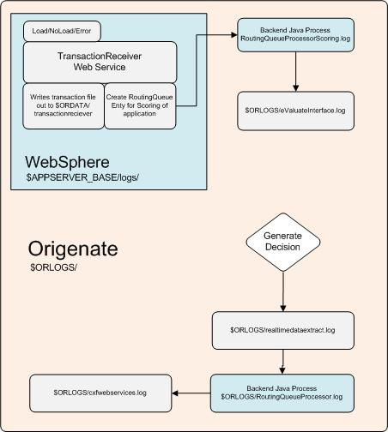
Origenate
WebSphere 8.5.5
Application ear structure
cfusion-ear.ear
cfusion-war.war
orig-servlet-war.war
orig-war.war
orig-branding-htmls.war
orig-ws.war
Backend Java
RoutingQueue Java
Adobe CF11
Coldfusion Console
Datasources
CFX tags
Thread tuning
Origenate base
admin, config, apps, log, data, rollout

Slide 10
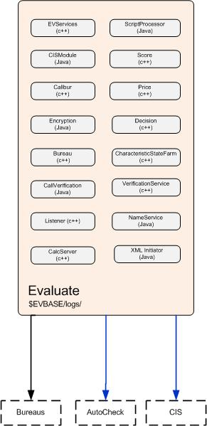
Evaluate
Evaluate Modules
EVServices (c++)
ScriptProccessor (java)
CISModule (java)
Score (c++)
Calbur (c++)
Price (c++)
Encryption (java)
Decision (c++)
Bureau (c++)
CharateristicsStateFarm (c++)
CallVerification (java)
VerificationService (c++)
Listener (c++)
NameService (java)
CalcServer (c++)
XMLInititator (java)

Slide 11
Database
Normalized Relational Database
Referential Integrity
DB functions for Calculations
Stored Procedures
DB Triggers for Auditing
Two Schema Origenate and Evaluate
Granted Permissions and Views
Oracle Database
Origenate
Schema
statefarm
Evaluate
Schema
eval_statefarm

Slide 12
Encryption
origenate
evaluate
SafeNet Appliance
Encrypting NPI
SSN
Credit Card Account Numbers (PANs)
Drivers License
Financial Account Number
Encrypting at Point of Capture
SafeNet Technology Hardware Appliances (HSMs)
Secure Key Management
Performance
Clustering & Redundancy
AES 256-bit Encryption

Slide 13
System Connectivity
ILA
User Update
Dealer Updates
Inbound via Web Services
Client Portals, Applications, Comments, Contracts
User Maintenance
Originator Maintenance
Initiated by Origenate
Decisions, CIS Requests, ACH
Servicing, Verification Services
Real-time Data Extracts
Origenate standard XML with XSLT transformations
Secure Data Transport
HTTPS
SFTP, PGP
Origenate/
Evaluate
CIS
ILA
Service

Slide 14
Section 2 Origenate Detail
Topics
Origenate Architecture
Origenate directory structure
Origenate DB connections
Origenate communications
Origenate configuration files
Origenate CFADMIN
Origenate Backend java applications

Slide 15
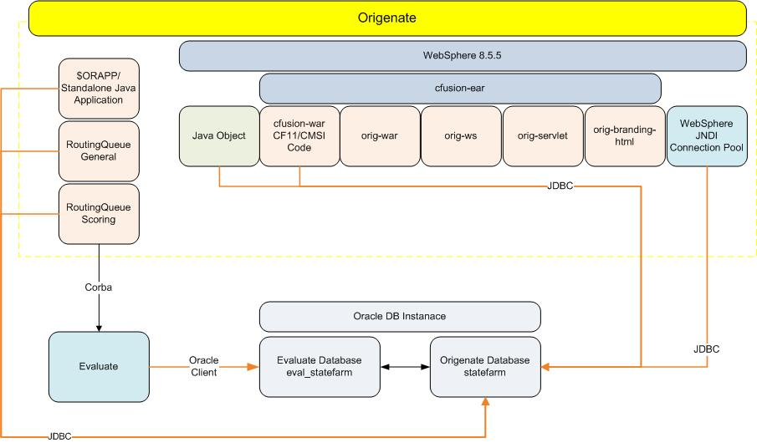
Origenate Architecture

Slide 16
Origenate Directory Structure
Origenate Structure for component
$BASE is the Origenate base folder containing: logs, java application, upgrade scripts &, administration scripts, application data file from jobs
$BASE/
admin/
apps/
config/
data/
db/
esapi/
log/
rollout/
tmp/
valueguide/
Origenate Structure for component
$APPSERVER_BASE/cfusion-ear.ear is the Origenate base for the deployed application ear containing the following war files:
$APPSERVER_HOME/cfusion-ear.ear
META-INF/
cfusion-war.war/
orig-branding-htmls.war/
orig-servlet.war/
orig-war.war/
orig-ws.war/

Slide 17
Enterprise Application Ear
cfusion-ear
Enterprise Application combining CF and Orientate Code
cfusion-ear
cfusion-war
Coldfusion code
Origenate cf code
orig-war
Origenate jsp code
orig-servlet
orig-branding-htmls
orig-ws
Java Servlets
Custom branding
Origenate web services
cfusion-war
War combining CF and Orientate Code
orig-war
Origenate war built on java code.
cfusion-servlet
Java servlets war. E.g TTYServlet, postreceive
cfusion-branding-html
Allows for custom branding of Origenate Portals
cfusion-ws
Origenate Web Service code for loading services and transactionreceiver

Slide 18
$BASE/
Folder | Description
admin/ | Systems administration script, backend java start scripts, Automated Jobs scripts
config/ | origenate.ini, usrconfig.sh, properties files
apps/ | Standalone Java code, Jar files, Stylesheets
log/ | Origenate applications logs, etc & rsl, saved reports
db/ | Application upgrade SQL and maintenance files.
data/ | Origenate data exported from standalone jobs for processing
rollout/ | Origenate automated rollout
tmp/ | Temporary application PID and reference files
valueguide/ | Valueguide load processing
esapi/ | OWASP security configuration files

Slide 19
Origenate $ORAPPS/
$ORAPPS is the Origenate code base for all standalone java applications.
$BASE/apps or $ORAPPS/
/opt/origenate/or_statefarm/apps/
applicationdelete/
documentarchive/
letterextract/
printfaxdocusign/
shawdealerextract/
apponedealerextract/
earlydisclosure/
lib/
printfaxqueue/
solicitationconverter/
appraisalalerts/
econtconverttopaper/
mpe/
purgeauditconfig/
solicitationlistdataload/
att/
edwextract/
mpeack/
purgeevent/
sqlrunner/
bookingbatchprocessor/
edwload/
nightlyletters/
releaseapplocks/
taffollowup/
cancelreferrals/
expiredoffer/
odedealerextract/
reportingexport/
taskexecutiontimecalculation/
concatletters/
generaldisbursements/
origaging/
reportretention/
tasktimeout/
connectwarepasswordutility/
healerts/
originatorextract/
rescission/
textletters/
deactivateuser/
hmdaextract/
originatorload/
routeonedealerextract/
withdrawapp/
dealerextract/
isbusinessday/
postqueue/
routingqueue/
xml/
Classpath for application is set through common location of usrconfig.sh
Application are called from $ORADMIN/ shell scripts written in korn shell
$ORAPPS/lib contains common jar files needed for standalone applications
$ORAPPS/xml contains common stylesheets used by standalone applications

Slide 20
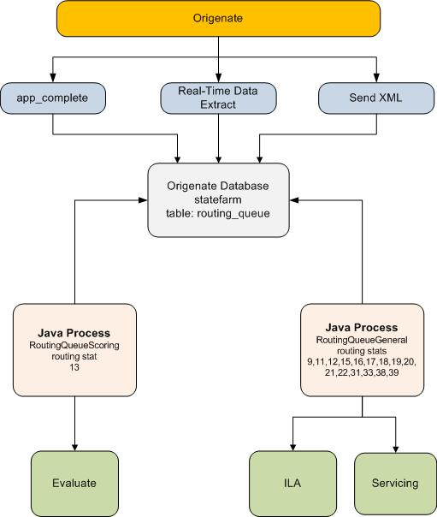
Origenate Backend Java

Slide 21
Origenate DB connection
Origenate uses three primary connections for processing.
Origenate.ini connection
TNS String (RAC Aware) - used by application java objects. Eg. RoutingQueue, PostingQueue, PrintFaxQueue, and Java objects with in Origenate CF code and Servlets. * Some objects like RoutingQueue are maintained connection and do not pool connection.
Oracle JDBC URL (Partial RAC Aware) – Used by Origenate Jasper Reports. JDBC connection using VIP and Service name.
ColdFusion Data source
Origenate, Evaluate, and ValueGuide connection used by ColdFusion Code. This connection is a jdbc:macromedia:oracle connection which the connection String properties are defined by Adobe.
WebSphere JNDI connection pool
Oracle J2EE application pool configured using Oracle JDBC using a TNS type connection values.

Slide 22
Origenate Configuration files
Origenate Base
$ORCONFIG/origenate.ini
$ORCONFIG/usrconfig.sh
$ORCONFIG/config.sh
Origenate Servlet INI files
$APPSERVER_HOME/cfusion-ear.ear/orig-servlet.war/config
TTYReportServlet.ini
webdocs.ini
postreceive.ini
TAFdocs.ini
VINDecodingServlet.ini

Slide 23
Origenate Web Service

Slide 24
Origenate CFADMIN console Settings

Slide 25
Section 3 Evaluate Detail
Topics
Evaluate Modules
Evaluate Directory Structure
Internal Evaluate Communications
Evaluate DB connections
Evaluate configuration files
Evaluate internal monitoring
Evaluate Bureau Files

Slide 26
What is eValuate?
Configurable rules engine that gives increased control over rules, automated decision, pricing, workflow, etc.
Automates bureau calling process
Scores application
Generates recommended decision
Calculates price-related values
Automatically routes applications

Slide 27
Evaluate Directory Structure
Evaluate $EVBASE is the Evaluate base for the Evaluate instance.
$EVBASE contains shell scripts, logs, code, automated code deployment, stylesheets, libs, Data folders for Bureau files, configuration files.
$EVBASE/
/evaluate/ev_statefarm/
APR/
libs/
rollout/
xml/
bin/
logs/
shl/
Data/
encConverter/
ini/
PROCESS/
upgrade_ev_db/

Slide 28
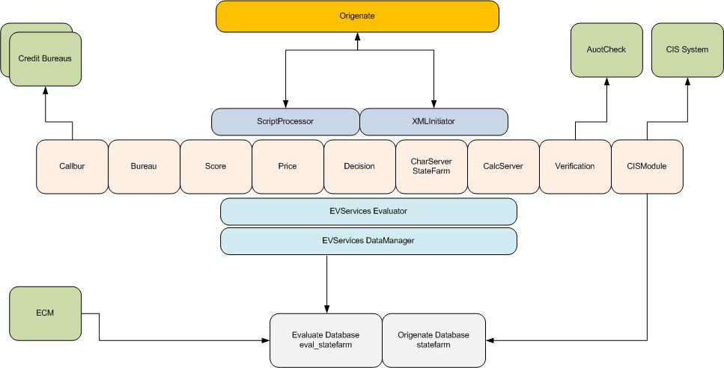
Evaluate Architecture

Slide 29
Evaluate Modules
EVServices (c++)
EVServices performs the functions of Data Manager and Evaluator. The Data Manager handles all interactions between the eValuate modules and the eValuate database.
The Evaluator determines the results of calculations and constructs as requested by the application processing modules. The Evaluator performs the requested function, then returns the results to the requesting module.
ScriptProccessor (java)
The Script Processor steps through the agent script and directs each module to execute its assigned tasks
Score (c++)
The Score module selects scorecards and uses them to evaluate applications to derive application scores and grades.
Calbur (c++)
Makes credit bureau connection for bureau pulls
Price (c++)
The Price module determines user-defined price-related values based on user-configured criteria.
Decision (c++)
The Decision module evaluates applications against initial and underwriting decision rules and combines the results to generate a credit approval decision.
Bureau (c++)
The Bureau module retrieves, summarizes, and stores credit data from consumer credit bureaus
Listener (c++)
The Listener collects and stores information it receives from the Bureau, Score, Decision, and Price modules about applications’ progress through eValuate and about the performance of eValuate’s processing modules.
The Listener manages response time metrics and trace information
CISModule (java)
Makes calls to external CIS system

Slide 30
Evaluate Modules
XMLInititator (java)
The XML Initiator is an alternate method for eValuate to communicate with an Origenate FES. The XML Initiator sends and receives data via XML-formatted text. The XML Initiator runs style sheets to convert the input XML to a standard eVXML format which it stores in the eValuate database. When returning response data from eValuate, the XML Initiator converts response data from eVXML to custom response XML formats.
CharateristicsStateFarm (c++)
Processes custom StateFarm logic
CallVerification (java)
VerificationService (c++)
Encryption (java)
Handles process of data encryption
NameService (java)
Creates Java Corba communication channel
CalcServer (c++)
Handles c++ calculations

Slide 31
Evaluate Configuration Files
Evaluate $EVBASE/ini
Evaluate location all Evaluate configuration files.
Database connection information
Corba Environment name
Clientid name for caching configuration on start up
Bureau connection
Verification service URL
Environment variables
Control what modules are started
Name Service port information
Bureau.ini
CalcServer.ini
callbur.ini
CallEngine.ini
CallVerification.ini
CharServer.ini
CharServerStateFarm.ini
CISModule.ini
Decision.ini
Encryption.ini
EVServices.ini
InitiatorX.ini
Listener.ini
modules.ini
omni.ini
Price.ini
Score.ini
ScriptProcessor.ini
VerificationService.ini
setenv.sh

Slide 32
eValuate Configuration
Basic Concepts
eValuate configuration is organized by PROJECTS assigned to a given effective date and time.
All constructs under one project share the same effective date.
A project contains only those constructs that were created or modified within that project.
An eValuate environment’s configuration is the sum total of all projects in that environment.
eValuate will always utilize the most recent construct based on the call’s effective date.
A project with an effective date that is in the past cannot be modified.

Slide 33
Touchpoints
A touchpoint initiates a transaction call to eValuate for the purpose of acquiring specific data or results.
Touch Points are points in Origenate where a call to eValuate is invoked.
This is controlled by Origenate programmatically
In eValuate, each touch point corresponds to an Agent Script.
The functions of each script can be configured using the ECM tool
Example: At the end of application entry (Application Complete) the MainEval touchpoint is invoked.
Effective Date –
The effective date of the application will determine the configuration to execute.
Agent Script –
An Agent Script contains the set of instructions that eValuate needs to follow for the call.
Request Data –
The specific application data required to execute the Agent Script.

Slide 34
Evaluate DB Connections
Evaluate uses two primary connections for processing.
TNS (RAC Aware) – Used by EVServices for all C++ application connection. Evaluate connection are maintained connection. Connection will start with base configured number of connections and grow as needed to Max connection limit defined.
TNS String (RAC Aware) - used by application java Modules. Eg. CISModule and TAFModule

Slide 35
Evaluate Internal Monitoring
Evaluate $EVBASE/sh/monitor.sh
Monitoring agent of Evaluate
Monitoring Evaluate PID
Check for active PID every 25 seconds
Logs information to $EVBASE/logs/Evaluate.log and $EVBASE/logs/Watchdog.log
Will create incident folder with all logs and restart if module stops unexpectedly

Slide 36
Evaluate Bureau Files
OUT file are the raw Data returned from bureuas
TTY file are the fromated readable data from bureuas
/evaluate/ev_startfarm/Data/Bureau_Files/EFX50/TTY/8
87071Masked.03302015141626.A1 – masked file
87071.03302015141626.A1 – encrypted file
/evaluate/ev_startfarm/Data/Bureau_Files/
Bureau Directory is a shared mount to DB
Origenate uses directory object for ablity to display TTY file to users

Slide 37
Section 4 Database Detail
Topics
Origenate Schema
Evaluate Schema
Directory Objects
Grants

Slide 38
Basic Structure

Slide 39
Section 5 Encryption Detail
Topics
SafeNet appliance
Communications with SafeNet
Users and Keys
DB Tables and how data is stored

Slide 40
Encryption

Slide 41
Encryption System Administration

Slide 42
Section 6 System Logs
Topics

Slide 43
Environment Variables
Variable | Example Value
$ORADMIN | /opt/origenate/or_anylender/admin
$ORAPPS | /opt/origenate/or_anylender/apps
$ORBASE | /opt/IBM/WebSphere/AppServer/profiles/ or_anylender/installedApps/svappd02Node04Cell/ cfusion-ear.ear/cfusion-war.war/origenate
$ORCONFIG | /opt/origenate/or_anylender/config
$ORDATA | /opt/origenate/or_anylender/data
$ORROLLOUT | /opt/origenate/or_anylender/rollout
$ORINI | =/opt/IBM/WebSphere/AppServer/profiles/or_anylender/installedApps/svappd02Node04Cell/cfusion-ear.ear/cfusion-war.war/config
$ORLOGS | /opt/origenate/or_anylender/log
$BASE | /opt/origenate/or_anylender
$CFLOGS | =/opt/IBM/WebSphere/AppServer/profiles/or_anylender/installedApps/svappd02Node04Cell/cfusion-ear.ear/cfusion-war.war/WEB-INF/cfusion/logs
$ADMUSER | qsadm
$APPSERVER_BASE | /opt/IBM/WebSphere/AppServer/profiles/or_anylender
$APPSERVER_HOME | /opt/IBM/WebSphere/AppServer/profiles/or_anylender/installedApps/svappd02Node04Cell

Slide 44
Application Logs

Slide 45
Section 7 System Processing
Topics
General Application Flow
Tracking Application processing

Slide 46
High-level Application Flow
ILA
Origenate Web Service
RoutingQueueScoring
Evaluate
Generate Decision
Real-Time Data Extract
RoutingQueue

Slide 47
Section 8 Code Deployment
Topics
Evaluate code deployment
Origenate code deployment
Manual change requirements
DB changes

Slide 48
Code Deployment System Administration

Slide 49
Section 9 System Administration
Topics

Slide 50
System Administration Guide

Slide 51
Section 10 System Maintenance
Topics

Slide 52
Log and Data file Maintenance
$ORLOGS/
Logs files are managed through script $ORADMIN/rotate.sh
$EVBASE/logs
Logs are rotated on each start of evaluate
On same day files are appended to previous days files
$ORDATA/
Date files are managed through script $ORADMIN/cleandata.sh
Configured in shell script for number of days files are kept on server
$APPSERVER_BASE/logs/
Log files managed through WebSphere Console settings
$CFLOGS/
Log files managed through CFADMIN Console settings

Slide 53
Managing Table Sizes
There are several tables within the Origenate and eValuate schemas that are used to track information. These tables can become quite large and should be cleaned out on a regular basis. The business should be consulted to determine the frequency of the cleanup and the date range that should be left in the tables. Typically clients run daily or weekly Cron jobs to clean up the identified tables keeping 7 – 30 days of data based on business input.
Below is the list of tables that typically require maintenance and review:
AUDIT_CONFIG_MAINTENANCE – Used to track the changes made via the configuration tools. There is a standalone job to clean up this table “purgeauditconfig” that can be ran from Cron.
CREDIT_REQUEST_XML – Stores copies of all externally posted applications as a ‘clob’, used for troubleshooting problems.
EVENT – Used to track non application related events; such as password changes and user logins. Events described in MSTR_Event. There is a standalone job to clean up this table “purgeevent” that can be ran from Cron.
EVALUATE_REQUEST_QUEUE – Tracks ansynchronize requests to eValuate when there are eValuate errors, doesn’t get very large but should be checked periodically to determine if it needs cleaned up.
EVALUATE_SHARE – Used to track notifications to eValuate to refresh the cache for an application. NOTE: Environments should be down to clear this table.
POSTING_QUEUE_HEADER – Table used to track requests being received from external sources. Below are the child tables associated with this function. This table should be monitor and if the number exceeds a specified threshold an alert should be sent, also records older than specified threshold should cleaned out.
.

Slide 54
PRINTFAX_QUEUE – Table used to track requests for printing and faxing documents. Below are the child tables associated with this function. Faxes that are successful will be automatically deleted from this table. This table should be checked periodically to ensure there are not a lot of failures that need to be investigated.
PRINTFAX_QUEUE_ATTACHMENTS – Used for attachments to Emails
PRINTFAX_QUEUE_RECIPIENTS – Destination for the emails, successful transactions will clean itself up.
PRINTFAX_QUEUE_VALUES – User entered data to be included with printed and/or faxed documents.
A script should delete all records from printfax_queue, printfax_queue_attachments, printfax_queue_recipients, and printfax_queue_values that are older than <business specified> days and count records before and after the purge.
ROUTING_QUEUE - Table used to manages requests that need action; such as decisions being sent to external sources

Slide 55
Section 11 System Monitoring
Topics

Slide 56
System Monitoring Guide

Slide 57
Section 12 Review
Topics

Slide 58
Section 12 Build Docs
Topics

Slide 59
BUILDENV

Slide 60
Build Doc

Slide 61
Deploy ECM

Slide 62
Build cfusion-ear

